Slide 1
21AIE301 FORMAL LANGUAGES AND AUTOMATA
Project Presentation

Slide 2
TEAM 13
NAME |  | ROLL NO
1 | ESWAR SUDHAN S K | CB.EN.U4AIE20015
2 | KARTHIK RAJA B | CB.EN.U4AIE20028
3 | KARTHIKEYAN M | CB.EN.U4AIE20029
4 | NALIN M R | CB.EN.U4AIE20041
5 | PRAGADISHWARAN K | CB.EN.U4AIE20051

Slide 3
TABLE OF CONTENTS
01
02
03
04
General Overview
Authentication
Encryption & Decryption
Implementation and Output

Slide 4
The aim of our project is to design and implement a Turing machine that can perform pattern matching on a given username and password, and then use this information to facilitate secure communication through the use of various cryptography functionalities such as encryption and decryption. The project emphasizes on the development of a secure system for verifying user identities and protecting sensitive data and will also serve as a valuable educational tool for understanding the principles of computation and cryptography.
Objectives of the project

Slide 5
General Overview
Using the Turing Machine as comparator which performs string matching , using this functionality we integrate this to user interface login page.
a)If the username and password matches then the user is redirected to the next page.
b)If the username and password do not match then the user is not granted access and login is failed .
The next page the server can send message to the client (client-server interaction) that is the message are encrypted on the sender side and decrypted is received by user side where we make use of 2 methods which perform encryption and decryption: Bit Flipping Cipher System and Caesar Cipher System
The primary automata in both of the above approaches is the Turing Machine
When can also observe that as the client receiver some information from the server , it is able to get the decrypted text.

Slide 6
01
AUTHENTICATION
Using String matching for Login system

Slide 7
String Matching using Turing Machine
Converting the string input into numbers
Next step involves the conversion of the numbers into binary format.
Comparing two numbers by comparing number of ‘1’s.
Comparing ‘1’s by marking them ‘X’.
If ‘1’s are remaining in left of ‘0’, then first number is greater.
If ‘1’s are remaining in right of ‘0’, then second number is greater.
If both ‘1’ are finished then both numbers are equal.

Slide 8
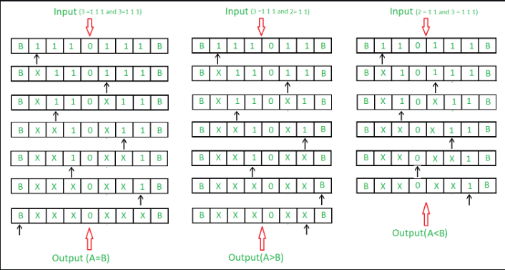
The above picture represents how the comparisons take place under the below conditions:
i. Comparator for A = B
ii. Comparator for A > B
iii. Comparator for A < B

Slide 9
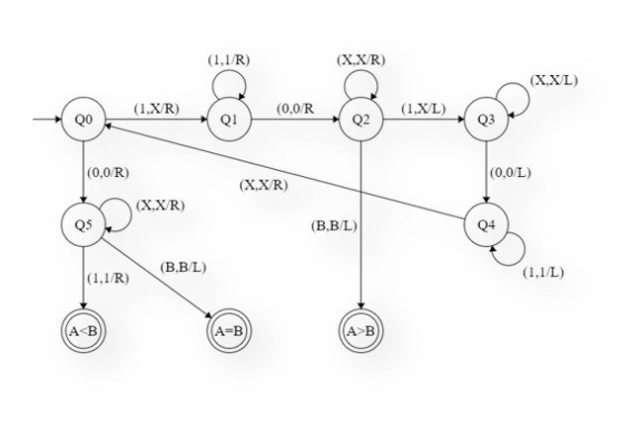
State transition diagram

Slide 10
Steps:-
Step-1: Convert 1 into X and move right and go to step 2. If symbol is 0 ignore it and move right and go to step-6.
Step-2: Keep ignoring 1 and move towards right. Ignore 0 move right and go to step-3.
Step-3: Keep ignoring X and move towards right. Ignore 1 move left and go to step-4. If B is found ignore it and move left and go to step-9.
Step-4: Keep ignoring X and move towards left. Ignore 0 move left and go to step-5.
Step-5: Keep ignoring 1 and move towards left. Ignore X move right and go to step-1.
Step-6: Keep ignoring X and move towards right. If B is found ignore it and move left and go to step-8. If 1 is found ignore it and move right and go to step-7.
Step-7: Stop the Machine (A < B)
Step-8: Stop the Machine (A > B)
Step-9: Stop the Machine (A = B)

Slide 11

02
Encryption using Bit Flipping & Caesar Cipher for secure connection

Slide 12
METHODS OF ENCRYPTION
BIT FLIPPING
Input- ’a’
In Binary- 01100001
Convert data to binary format.
Flip the bits and get a new encoded message
This method is quite vulnerable to attacks and is not entirely safe.
After Flipping- 10011110
Character corresponding- '\x9e'

Slide 13
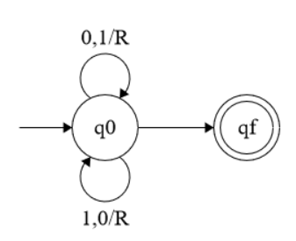
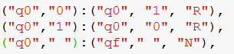
Turing Machine for Bit Flipping
B/B,N
q0 → initial state
qf → final state
N → Left/Right

Slide 14
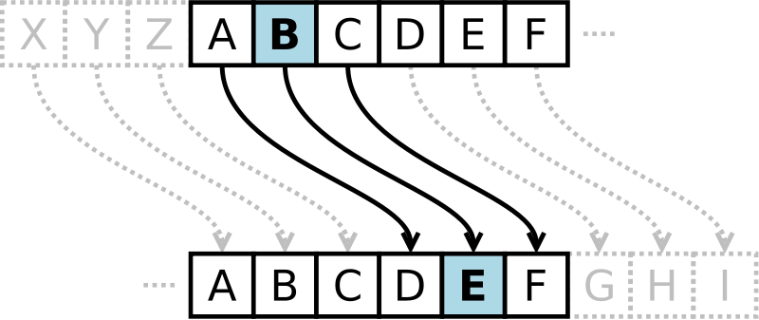
Caesar Cipher
A Caesar Cipher with a shift of 3.
Earliest and simplest method of encryption technique.
Each letter of a given text is replaced by a letter some fixed number of positions down the alphabet.
To cipher a given text we need an integer value(shift)
Shift → No. of position each letter of the text has been moved down.

Slide 15
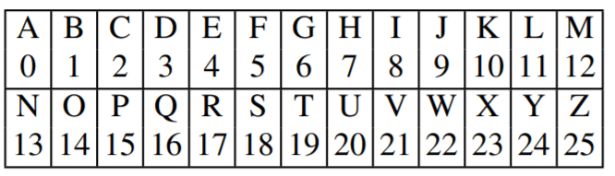
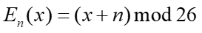
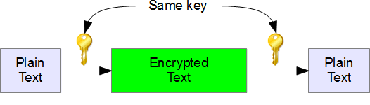
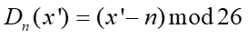
Caesar Cipher
The encryption can be represented using modular arithmetic by first transforming the letters into numbers, according to the scheme,
Encryption of a letter by a shift ’n’
The Decryption of a letter by a shift ‘n’

Slide 16
Caesar Cipher
The entire system cannot be done using a single-tape Turing machine.
So, the steps involved in encryption is done in different Turing machines and then combined all of them together to achieve the encryption.
The following are the Turing Machines designed:
Turing machine for Addition
Turing machine for Subtraction
Turing machine for Modulus

Slide 17
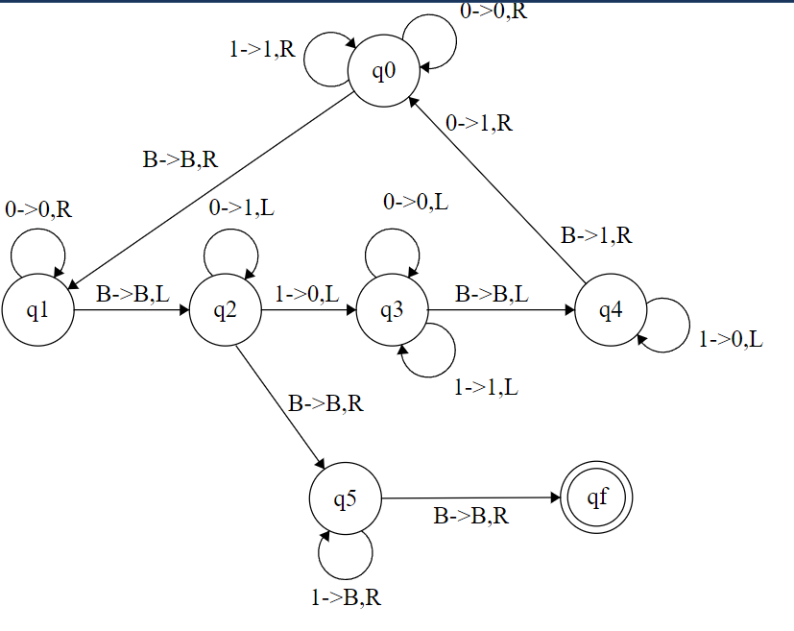
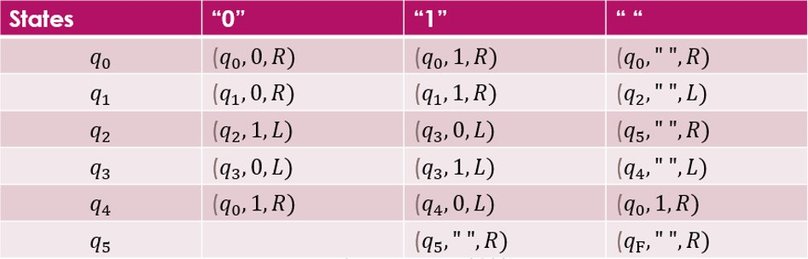
Turing Machine for addition
The addition Turing machine is used to shift the letters of the plaintext a certain number of positions down the alphabet during the encryption process.

Slide 18
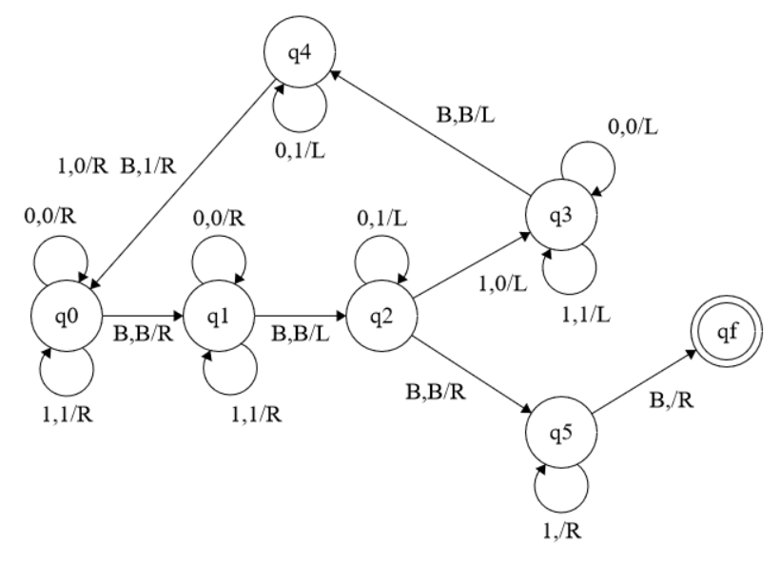
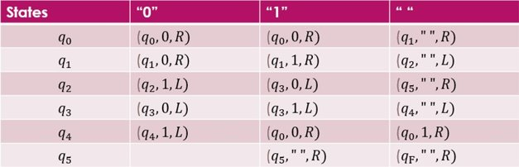
Turing Machine for subtraction
The subtraction Turing machine is used to shift the letters of the ciphertext a certain number of positions up the alphabet during the decryption process.

Slide 19
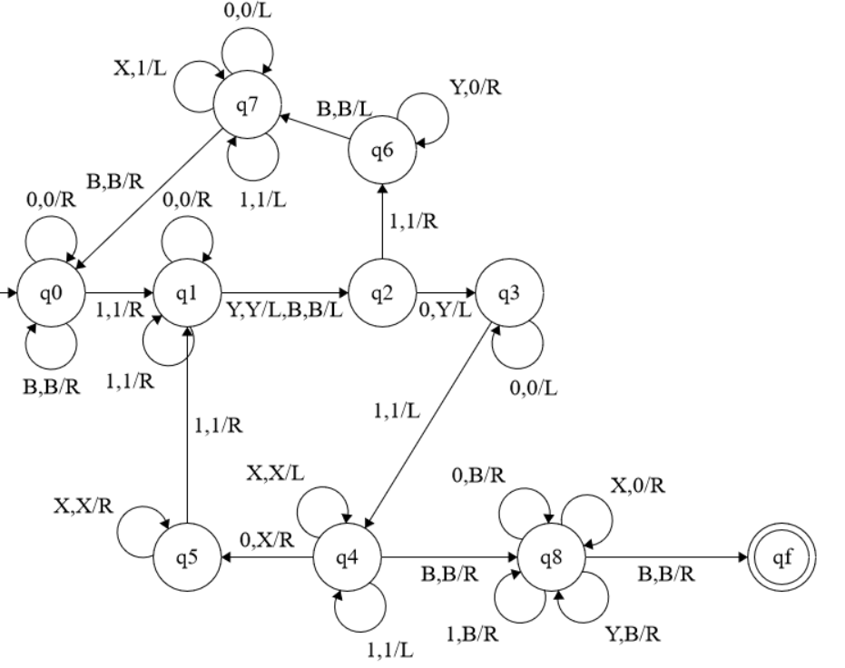
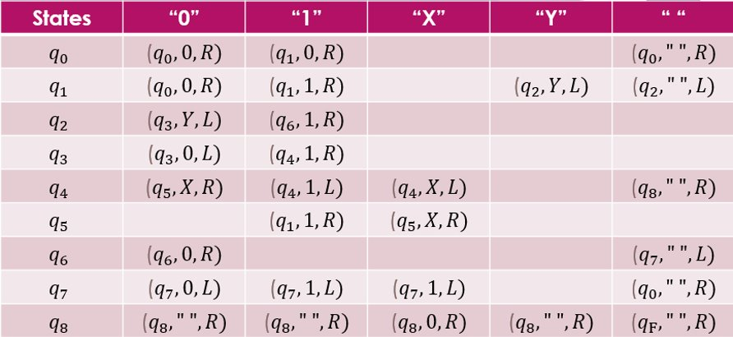
Turing Machine for Modulus
The modulus Turing machine is used to ensure that the shift value remains within the range of valid ASCII values for letters (i.e., from 65 to 90 for uppercase letters and from 97 to 122 for lowercase letters).
This is necessary because the Caesar cipher wraps around the alphabet, so if the shift value is greater than 26 (the number of letters in the alphabet), we need to take the remainder after dividing the shift value by 26 to get a value that is within the valid range.

Slide 20
Caesar Cipher
Using the three Turing machines designed above we obtain the hash maps for encryption and decryption.
Using these hash maps we design another Turing machine which encrypts the message and decrypts the cipher.

Slide 21
Advantages of Turing Machine over other Automata
Turing machines are a mathematical model of computation that can be used to represent any algorithm. This makes them a very general and powerful tool for studying algorithms.
Turing machines are easy to reason about and analyse. There are well-developed techniques for analysing the complexity of algorithms that are implemented on Turing machines, which makes them a good choice for studying encryption and decryption algorithms.
Turing machines can be used to study a wide range of encryption and decryption algorithms, including both symmetric and asymmetric algorithms. This makes them a very flexible tool for studying these algorithms.

Slide 22
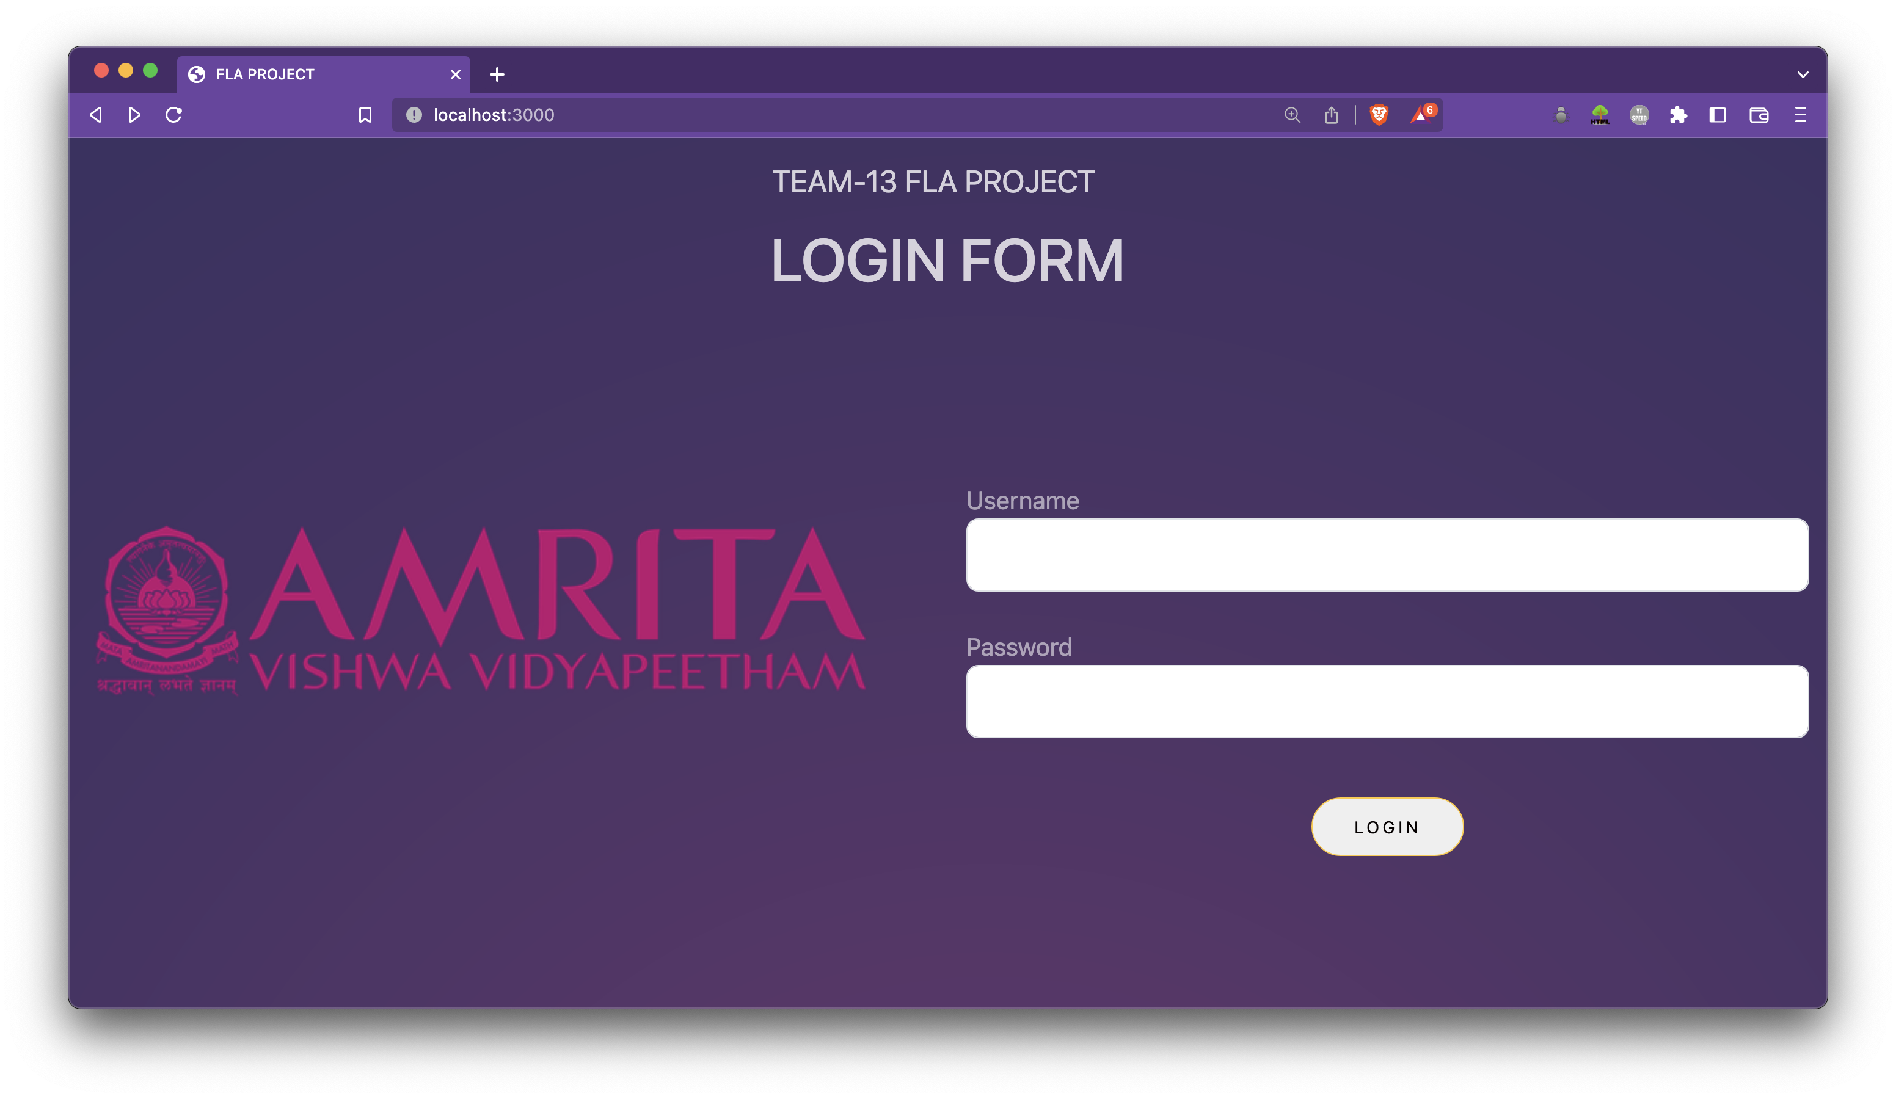

Slide 23


Slide 24
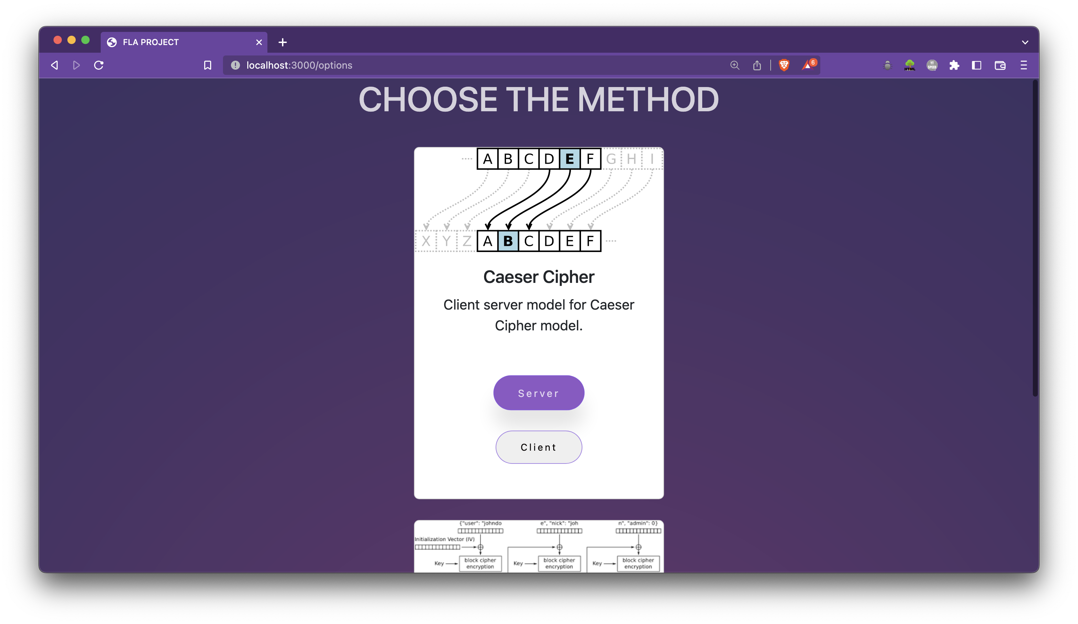

Slide 25
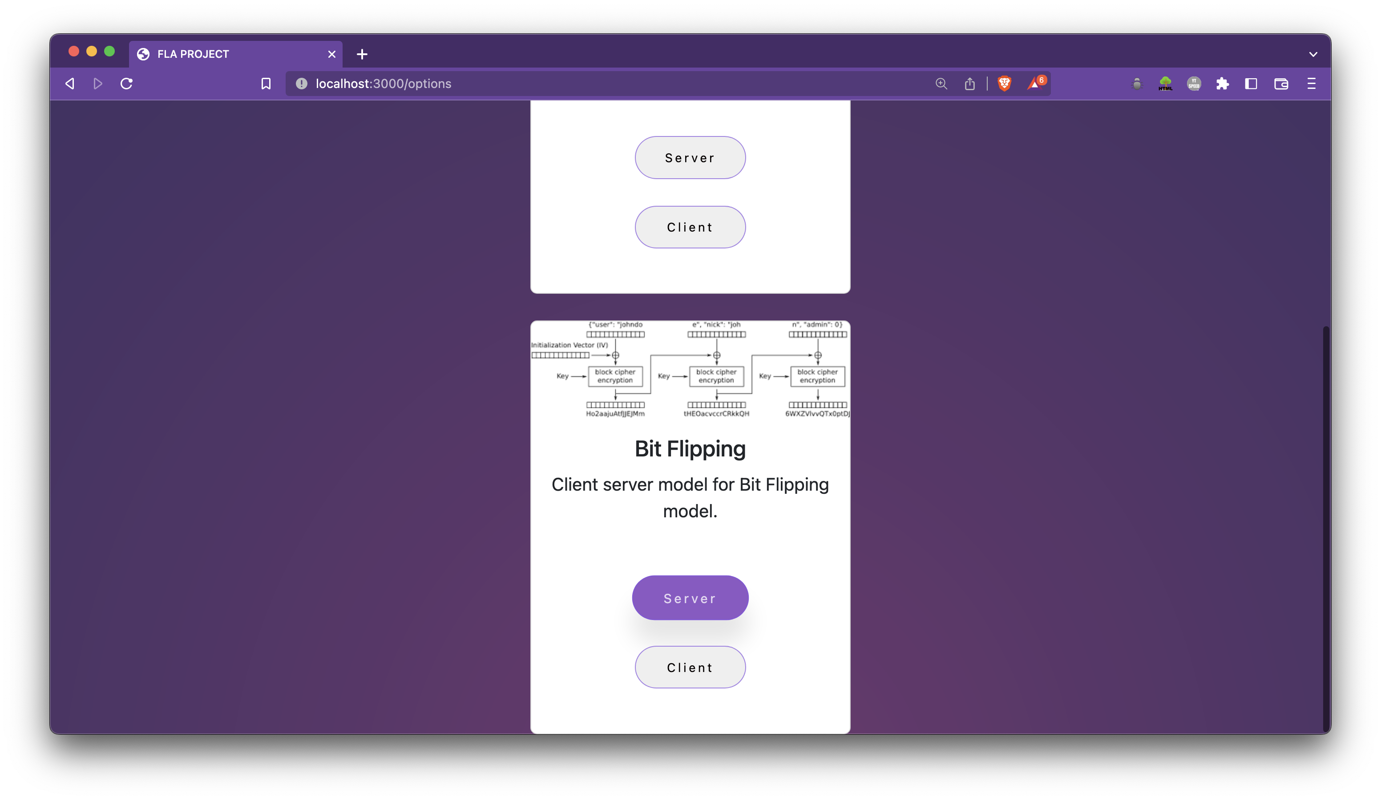

Slide 26
THANK YOU
TEAM 13

